Slide 1
Knowledge Representation and Insights Generation from Structured Datasets
Mentor:
Dr. T V Rajini Kanth
Professor and Head of the department, CSE AI&Ml
By Team Alphabet
Srivani Konda(21311A6627)
Vishnu Vardhan(21311A6607)
Deva Harsha(21311A6641)
Koushik Reddy(22311A66D1)
Laxmi Chandana(22311A6609)

Slide 2
Problem Statement
In the current data-driven world, organizations are inundated with vast amounts of structured data from various sources such as transactional databases, customer records, financial reports, and sensor data. Despite the abundance of data, deriving meaningful insights and actionable knowledge from these structured datasets remains a significant challenge. This is due to the complexities involved in data integration, the heterogeneity of data formats, and the difficulty in identifying patterns and trends without sophisticated analytical tools. Moreover, traditional methods of data analysis often fall short in effectively representing the knowledge embedded within these datasets, leading to underutilization of valuable information and missed opportunities for strategic decision-making.

Slide 3
Solution
To address these challenges, a robust framework for knowledge representation and insights generation from structured datasets is essential. This involves leveraging advanced data processing techniques, such as machine learning and artificial intelligence, to transform raw data into comprehensible knowledge. By implementing automated data integration processes, data from diverse sources can be unified into a cohesive structure.
Here's an overview of the typical steps to address these challenges:
Data Integration
Data Cleaning and Preprocessing
Data Analysis
Data Visualization
Knowledge Representation

Slide 4
Solution
To address these challenges, a robust framework for knowledge representation and insights generation from structured datasets is essential. This involves leveraging advanced data processing techniques, such as machine learning and artificial intelligence, to transform raw data into comprehensible knowledge. By implementing automated data integration processes, data from diverse sources can be unified into a cohesive structure.
Here's an overview of the typical steps to address these challenges:
Data Integration
Data Cleaning and Preprocessing
Data Analysis
Data Visualization
Knowledge Representation

Slide 5
Features of the project
The objective of this project is to develop a comprehensive framework for knowledge representation and insights generation from structured datasets. This framework will integrate advanced data analytics, machine learning techniques, and visualization tools to transform raw data into actionable knowledge.
Achieved Milestones :
Data Collection and Preprocessing
Chat with Structured data and asking it for knowledgeable insights
Visualization of structured datasets
Connecting the structured databases directly to the application

Slide 6
Motivation
:
Developing solutions for integrating heterogeneous data sources to ensure consistency and coherence in the combined dataset.
Balancing the trade-off between the complexity of analytical models and their efficiency, as organizations require real-time analysis with high accuracy.
Gaining hands-on experience with advanced data analysis algorithms and tools to enhance their practical implementation.
Contributing to the field of data science by innovating new methodologies and tools that can overcome the limitations of traditional data analysis.
Maximizing the strategic value of structured data by developing systems that can automatically extract and summarize knowledge, thereby reducing the reliance on human intervention and expertise.

Slide 7
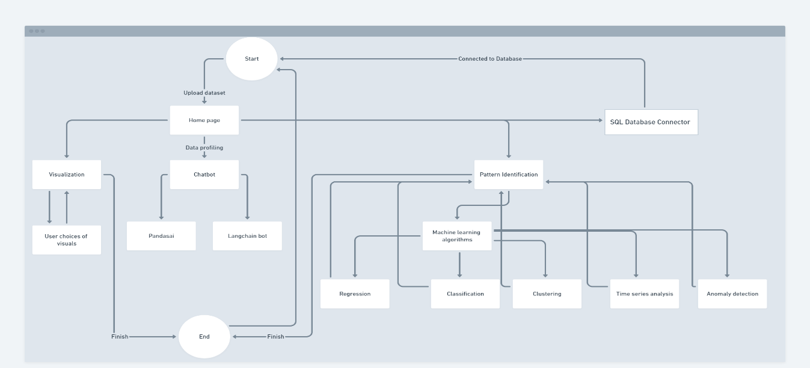
Architecture

Slide 8
Tech Stack
Pandas: Pandas is a fast, powerful, flexible, and easy-to-use open-source data analysis and manipulation library built on top of the Python programming language. It provides data structures like Data Frames and Series to efficiently handle large datasets and perform complex data analysis tasks.
Streamlit: Streamlit is an open-source Python library that makes it easy to create and share beautiful, custom web apps for machine learning and data science. Streamlit transforms data scripts into interactive web applications, making it simple to visualize data and model outputs.
OS: The OS module in Python provides functions for interacting with the operating system. It allows for the manipulation of files and directories, accessing environment variables, and performing other operating system tasks.
Sklearn: Sklearn (Scikit-learn) is a machine learning library for Python. It features various classification, regression, and clustering algorithms, including support vector machines, random forests, gradient boosting, k-means, and DBSCAN. It is designed to interoperate with the Python numerical and scientific libraries NumPy and SciPy.

Slide 9
Tech Stack
PandasAI: PandasAI is an extension of the Pandas library, which leverages artificial intelligence to enhance data manipulation and analysis capabilities. It integrates machine learning algorithms directly into the Pandas workflow, providing intelligent data processing features.
LangChain: LangChain is a library for building applications with language models. It provides a framework to create agents and tools that can interact with language models, enabling the development of sophisticated natural language processing applications.
Gemini: Gemini is a Python library designed for advanced data analysis and machine learning. It offers tools for data preprocessing, feature engineering, and model training, providing a comprehensive solution for developing and deploying machine learning models.

Slide 10
Team Members and their Contributions
Srivani Konda (21311A6627) – contributed in building the langchain agent for knowledge representation from structured data sets
Vishnu Vardhan (21311A6607 ) – contributed in building the pattern identification feature using ML algorithms
Deva Harsha (21311A6641) – contributed in building the SQL connector feature where structured datasets can be connected to the application
Koushik Reddy (22311A66D1) – contributed by visualizing datasets and working with PandasAI to integrate application to visualize structured datasets
Laxmi Chandana (22311A6609) – contributed in building the application

Slide 11
Conclusion
We have analysed Iris dataset, and developed a program to derive actionable insights from structured data and generate insights from data sets. Learned how to work on large-scale projects, and use pre-trained models to implement the solution. Successfully implemented LangChain and PandasAI to deliver insights and visualize the datasets. This project explores these challenges and discusses advanced methodologies to enhance the extraction of actionable insights from structured datasets.

